Slide 1

On Becoming A Leader In Risk Management
Fundamentals of RM
RM System and Process
Leadership in RM
Incident Investigation
RM Tools & Challenges
RM in Industry
People & Org.
Applications & Perspectives
ENGG404 – Lecture
Chapter 6.4: Professionalism, Ethics and Equity, Integrity, and Conflict Of Interest
1
Notes:
ENGG404 2014F
1
ENGG404 Lecture 00 - Day 1
2012 Fall
1
1
26 November 2019

Slide 2
Show this video before class starts.
Chapter 6.4: Professionalism, Ethics and Equity, Integrity
“Leading the Way to a Safer World”
https://drive.google.com/open?id=1HbT-vllIsbYmhUBU4TbNzLMtyACmKDo8
Pathway: TeamDrive > ESRM Instruction Team Resources > Video Clips >
52 Ch6.4 Professionalism CCPS Leading the Way to a Safer World.mp4
Center for Chemical Process Safety, a technological community within the American Institute for Chemical Engineering
00:00 – 02:20
At 2:20, pause and look for familiar firms as the credits roll.
02:21 – 02:45
https://www.youtube.com/watch?v=7xjpUIEwVUM
Note: Although this video may seem centric to chemical engineering, all petrochemical manufacturing industries require and rely on the expertise of all engineering disciplines.
Consider: excavations, foundations and infrastructure, power distribution, waste water treatment, air pollution controls, computer and automatic process controls, networks and information technologies, structures, pressure vessels and piping systems, materials of construction, machines and machinery, instrumentation and electrical systems, chemical process units, resource extraction for raw materials, conversion of raw materials to finished products, logistics and transportation; design, fabrication, construction, start-up, operations, maintenance, financial management, and operations management.
Chapter 6.4: Professionalism, Ethics and Equity, Integrity, Conflict of Interest
2

Slide 3
Learning Outcomes
We will explore the question, “What does it mean to be an upstanding and outstanding professional engineer?”
Explain professionalism and analyse a situation about professionalism.
Explain ethics, and analyse a situation about ethical (and unethical) behaviour:
Examine and critique a situation where an engineer’s professional ethics, integrity, or professional practice may be called into question, and recommend the best course of action.
Gauge an organization’s or a leader’s decision-making process on a scale of ethical behaviour.
Manage apparent contradictions and ambiguities during your career within your organization.
Chapter 6.4: Professionalism, Ethics and Equity, Integrity, Conflict of Interest
3
Notes:
ENGG404 2014F
3
3
26 November 2019

Slide 4
The Practice of Engineering:
Some points about the practice of engineering:
Technologically complex
Large contribution to society, and for the benefit of society
Ethical obligations.
You could be asked to choose one of the first two, and describe in terms relevant to the practice of engineering; however, the CCPS video clearly illustrated these two.
Having said this, you should take an opportunity to reflect on the relevancy of “technologically complex” or “large contribution to society” that involved the organization from your team project.
The third item will be discussed further in this lecture.
Chapter 6.4: Professionalism, Ethics and Equity, Integrity, Conflict of Interest
4
Notes:
ENGG404 2014F
4
4
26 November 2019

Slide 5
Professionalism in Engineering
A profession is a calling that requires:
Specialized knowledge,
Intensive preparation,
High standards of achievement,
High standards of practice,
Continued study,
Ethical conduct, and
Public service (duty to the public).
Http://www.apega.ca/pdf/guidelines/professionalism.pdf
As engineering students, you can readily identify with these.
So we will explore these in this lecture.
Chapter 6.4: Professionalism, Ethics and Equity, Integrity, Conflict of Interest
5
Notes:
ENGG404 2014F
5
5
26 November 2019

Slide 6
Professionalism in Engineering
CCPE defines the “practice of engineering” as: “the practice of professional engineering means any act of planning, designing, evaluating, advising, reporting, directing or supervising, or managing any of the foregoing, that requires the application of engineering principles, and that concerns the safeguarding of life, health, property, economic interests, the public welfare, or the environment.”
An example from BP-DWH:
Directing or Supervising
Although there were many reports about the failures in the BOP, there was insufficient management oversight (direction and supervision) about i) the possible impacts if there was a blow-out that could not be mitigated, and ii) the appropriate actions to restore the BOP to effective operation or to delay “production” (well completion) until restored.
Incident Reporting, Investigation, Analysis, and Actions
Chapter 6.4: Professionalism, Ethics and Equity, Integrity, Conflict of Interest
6
Notes:
ENGG404 2014F
6
6
26 November 2019

Slide 7
Recall: The Role of APEGA
Administers the Engineering, Geological And Geophysical Professions Act Of Alberta
Self governing: APEGA is empowered by the act to govern its members without oversight or intervention by the provincial government.
Serves the public interest
Ensures high standards of practice
Ensures only properly qualified people are allowed to practice
Enforceable code of ethics
As professionals, we have a responsibility under the professional engineers act to perform our roles appropriately and ethically.
Chapter 6.4: Professionalism, Ethics and Equity, Integrity, Conflict of Interest
7
Notes:
ENGG404 2014F
7
7
APEGA disciplinary committee example – woman caught falsifying water testing results for a company in the province
Essentially submitted the same results as for 2014 in 2017.
License to practice was revoked for 3 years and paid a $10,000 fine.
26 November 2019

Slide 8
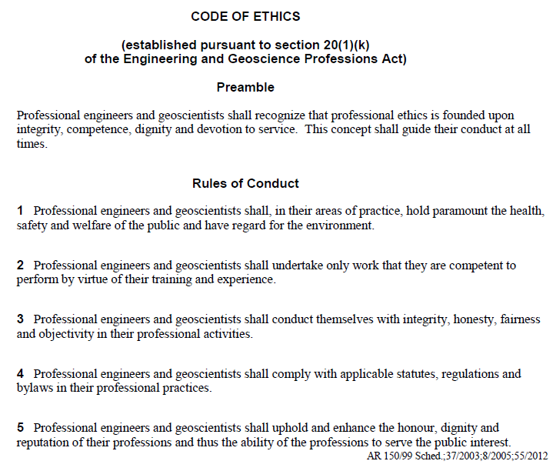
APEGA Code of Ethics – An Excerpt
Engineering
Flixborough
Discuss
APEGA, OHS
Chapter 6.4: Professionalism, Ethics and Equity, Integrity, Conflict of Interest
8
Notes:
8

Slide 9
Why Professionalism and Ethics in Engineering?
Without due care and diligence, our professionalism and ethics could be called into question,
No one wants this to happen in their careers.
Cases of alleged professional misconduct, unethical behaviours, incompetence, negligence, corruption, have lead to investigations and charges against professional engineers.
Such actions are far from the standards of professionalism, ethics, integrity and avoidance of conflict of interest that the public and our profession demand of its members.
At stake: our reputation, our credibility, our career, and our ability to work in the profession.
Chapter 6.4: Professionalism, Ethics and Equity, Integrity, Conflict of Interest
9
Notes:
ENGG404 2014F
9
9
26 November 2019

Slide 10
Revisit the Definition of Professional Engineering:
Revisit “… that concerns the safeguarding of life, health, property, economic interests, the public welfare or the environment”
.. “Safeguarding” means “the protection of”
“Economic interests” means:
PEAP - assets and production / productive capacity
Business interests
The funds and resources (including confidential information and data) entrusted to us.
Chapter 6.4: Professionalism, Ethics and Equity, Integrity, Conflict of Interest
10
Notes:
ENGG404 2014F
10
10
26 November 2019

Slide 11

Revisit the Definition of Professional Engineering:
The manner in which we manage those resources and the decisions we make concerning those funds are fundamentally based on our values.
Revisit this thought experiment … a lesson in “values”: you are walking the down the hall-way …
Our values drive our decisions!
Chapter 6.4: Professionalism, Ethics and Equity, Integrity, Conflict of Interest
11
Notes:
ENGG404 2014F
11
11
26 November 2019

Slide 12
Areas of Potential Ethical Problems
We may be entrusted with sensitive (confidential, proprietary, private, personal) information that could give an unfair advantage to one party over another.
This unfair advantage could be unethical or illegal!
Our decisions about using that information or decisions based on that information must adhere to our principles and our ethics.
Professionalism, ethics and equity (accountability) means that your decisions as a professional engineer must fall within the meaning of professional engineering.
Chapter 6.4: Professionalism, Ethics and Equity, Integrity, Conflict of Interest
12
Notes:
ENGG404 2014F
12
12
26 November 2019

Slide 13
Areas of Potential Ethical Problems
Case Study:
You are a petroleum engineer working for a well-survey company.
You learn about much higher than expected reserves through a report that comes across your desk.
The client of the well survey company owns this intellectual property, the report.
You recognize that this information is valuable to yourself and/or someone outside of the organization.
Possible decisions:
Call your broker to buy stock in the client company.
Contact a competitor and sell the information.
Discuss the information only with authorized persons in your company.
The right and only decision:
Discuss the information only with authorized persons in your company.
Values: Rightful ownership of intellectual property. Client confidentiality and secured IP. Honesty. Integrity. Accountability in your job as an employee.
Chapter 6.4: Professionalism, Ethics and Equity, Integrity, Conflict of Interest
13
Notes:
ENGG404 2014F
13
13
26 November 2019

Slide 14
Ethical Approaches (APEGA):
Ethics is the study of the moral issues and making decisions that confront individuals and organizations i.e. “right and wrong”.
Ethics can be further refined as:
Virtue ethics – values, internally imposed codes
Utilitarianism – greatest good for largest number
Duty ethics – externally imposed codes & laws
Rights ethics – human rights trump all
Ethical Egotism – do what is best for you
Chapter 6.4: Professionalism, Ethics and Equity, Integrity, Conflict of Interest
14
Notes:
ENGG404 2014F
14
14
26 November 2019

Slide 15
Our Hierarchy in Applying Our Ethics:
As professional engineers, and to one extent or another, most of us apply this “ethics hierarchy” in our decision making:
I comply with the law. (Duty ethics – externally imposed codes & laws)
I comply with the professional code. (Duty ethics – externally imposed codes & laws)
I protect the public welfare. (Utilitarianism – greatest good for largest number)
I acknowledge the rights of people. (Rights ethics – human rights trump all)
I will not compromise my personal values. (Virtue ethics – values, internally imposed codes)
When we apply our ethics to make a decision, we ask ourselves:
In what order do our tests occur?
Which tests are missing / added to your list?
What is our personal bottom line?
(see also the APEGA presentation)
Chapter 6.4: Professionalism, Ethics and Equity, Integrity, Conflict of Interest
15
Notes:
ENGG404 2014F
15
15
26 November 2019

Slide 16
Our Hierarchy in Applying Our Ethics:
Case Study:
Now consider the ethics that you applied in reaching the right and only decision: “Discuss the information only with authorized persons in your company.”
We applied our ethics in this order.
I comply with the professional code. (Duty ethics – externally imposed codes & laws)
I comply with the law. (Duty ethics – externally imposed codes & laws)
I will not compromise my personal values. (Virtue ethics – values, internally imposed codes)
Chapter 6.4: Professionalism, Ethics and Equity, Integrity, Conflict of Interest
16
Notes:
ENGG404 2014F
16
16
Even if we did not know about “insider trading”, we do know about our professional code of ethics and responsibility to our employer and by extension our client.
Personal values may or may not come into play. For example, we may highly value wealth and money, but realize that the consequences of using this confidential information may out-weight any benefit.
26 November 2019

Slide 17
An Example: Integrity and Ethical Behaviour
Two “ideas” about of integrity and ethical conduct:
1) Doing the right thing at the right time.
This is very easy to do if it is a positive or a pleasant choice.
It is not easy to do when it is not positive, nor pleasant, nor popular.
2) Doing the right thing at the right time when nobody is watching.
The situation: The regional Investigations and Enforcement Branch of the provincial Ministry of the Environment calls on your plant with a search warrant. You and your supervisor are tasked with aiding the search.
The issue: You find a “compromising document”, you realize it can be harmful to the company.
Possible decisions: What are some possible decisions?
Make the Decision: What are the unethical, ethical, and legal decisions?
Chapter 6.4: Professionalism, Ethics and Equity, Integrity, Conflict of Interest
17
Notes:
ENGG404 2014F
17
17
26 November 2019

Slide 18
Integrity and Ethical Behaviour:
Two “ideas” about of integrity and ethical conduct:
1) Doing the right thing at the right time.
This is very easy to do if it is a positive or a pleasant choice.
It is not easy to do when it is not positive, nor pleasant, nor popular.
2) Doing the right thing at the right time when nobody is watching.
The situation: The regional regional IEB of the MoE calls on your plant …
The issue: You find a “compromising document”, you realize it can be harmful to the company.
Possible decisions:
Destroy the document. Unethical, possibly illegal!
Replace the document for their discovery. Ethical AND legal.
Give the document to the investigators Ethical or unethical? From your employer’s perspective, this is certainly contrary to your employer’s interests, and therefore they may consider it unethical.
Chapter 6.4: Professionalism, Ethics and Equity, Integrity, Conflict of Interest
18
Notes:
ENGG404 2014F
18
18
26 November 2019

Slide 19
Ethical Behaviour & the Decision-Making Process:
Consider applying ethics in the span of decision making:
Unethical Ethical
Collusion … Coercion … Co-option … Co-operation … Collaboration
On ideas expressed By Mark Flint, P.Eng., Former CEO APEGA
Q: As professionals, where must we be?
We must strive to be at the green end – cooperation and collaboration!
Usually most teams are at co-operation. Certainly collaboration is most desirable. We coach for this and teams strive for this.
Chapter 6.4: Professionalism, Ethics and Equity, Integrity, Conflict of Interest
19
Notes:
ENGG404 2014F
19
19
Co-option is assimilating opposition from members of a group by appointing members supportive of the ideas of the rest of the group
26 November 2019

Slide 20
Integrity and Ethical Behaviour:
Two “ideas” about of integrity and ethical conduct:
1) Doing the right thing at the right time.
This is very easy to do if it is a positive or a pleasant choice.
It is not easy to do when it is not positive, nor pleasant, nor popular.
2) Doing the right thing at the right time when nobody is watching.
The situation: The regional regional IEB of the MoE calls on your plant …
The issue: You find a “compromising document”, you realize it can be harmful to the company.
Possible decisions:
Destroy the document. Unethical, possibly illegal! Collusion.
Replace the document for their discovery. Ethical AND legal. Cooperation.
Give the document to the investigators.
Chapter 6.4: Professionalism, Ethics and Equity, Integrity, Conflict of Interest
20
Notes:
ENGG404 2014F
20
20
26 November 2019

Slide 21
Integrity and Ethical Behaviour
Two “ideas” about of integrity and ethical conduct:
1) Doing the right thing at the right time.
This is very easy to do if it is a positive or a pleasant choice.
It is not easy to do when it is not positive, nor pleasant, nor popular.
2) Doing the right thing at the right time when nobody is watching.
Both, indeed, are ideal and challenging; however, the latter can be more challenging because it presents an opportunity to make an unethical decisions, or a decision lacking integrity.
Chapter 6.4: Professionalism, Ethics and Equity, Integrity, Conflict of Interest
21
Notes:
ENGG404 2014F
21
21
26 November 2019

Slide 22
The Dilemma: Stay the Course of Ethical Conduct or Acquiesce?
Challenges in your career:
Pressure created by conflicting values.
Temptation to benefit.
Will you have the courage to make the right ethical decision when there is pressure to compromise?
Or will you give in to pressure or temptation?
How will you evaluate such an ethical challenge?
By applying the principles reviewed!
Chapter 6.4: Professionalism, Ethics and Equity, Integrity, Conflict of Interest
22
Notes:
ENGG404 2014F
22
22
26 November 2019

Slide 23
The Dilemma: Stay the Course of Ethical Conduct or Acquiesce?
You may be able to discuss an ethical challenge you have faced already.
Consider these questions in regard to your personal work experience or team project:
What is the situation?
What is the issue with that situation in terms relative to ethical conduct?
What did you do (or what should you have done), again, in terms relative to ethical conduct?
What was (or would have been) the final result or outcome?
You should be prepared to discuss your ethical challenge relative to your work experience or your team project loss incident …
Chapter 6.4: Professionalism, Ethics and Equity, Integrity, Conflict of Interest
23
Notes:
ENGG404 2014F
23
23
26 November 2019

Slide 24
Predicament: Manage Apparent Contradictions & Ambiguities?
The predicament: how will you manage apparent contradictions and ambiguities in your new workplace?
Your situation: you are a new graduate ...
Your predicament:
Actions of the organization seem to contradict the values of the organization, or
Organizational values seem to contradict your sound set of risk management principles and values.
Please think about your predicament.
What are three possible decisions you could make?
What do you need to consider in making a decision as to what to do?
Chapter 6.4: Professionalism, Ethics and Equity, Integrity, Conflict of Interest
24
Notes:
ENGG404 2014F
24
24
26 November 2019

Slide 25
Predicament: Manage Apparent Contradictions & Ambiguities?
What do you do? Three possible choices:
Degrade your values?
Leave the organization?
Undertake initiative?
We implore you … do not degrade your values!
If and when you degrade or compromise your values, you may allow such things as condoning unacceptable behaviours, or you may be motivated to meet objectives that could put PEAP at risk; ultimately this could result in a significant loss incident.
Chapter 6.4: Professionalism, Ethics and Equity, Integrity, Conflict of Interest
25
Notes:
ENGG404 2014F
25
25
26 November 2019

Slide 26
Predicament: Manage Apparent Contradictions & Ambiguities?
So, two choices remain:
Degrade your values?
Leave the organization?
Undertake initiative?
For b) and c), it ultimately depends on your position in your career, your scope of responsibility, and your level of influence.
New graduate, early in your career:
Can you influence your small organization, your area of responsibility, your circle of influence? Will it make a difference? Do you feel up to the challenge? If so, undertake initiative.
If none of these, then an acceptable decision is to leave the organization. This is neither a wrong nor less than desirable decision.
Chapter 6.4: Professionalism, Ethics and Equity, Integrity, Conflict of Interest
26
Notes:
ENGG404 2014F
26
26
26 November 2019

Slide 27
Predicament: Manage Apparent Contradictions & Ambiguities?
So, two choices remain:
Degrade your values?
Leave the organization?
Undertake initiative?
Fast-forward, a highly competent leader in risk management: How will you respond in your future role as a competent leader?
You have the ability to influence change within your area of responsibility.
So now it depends on a) your willingness to take on the challenge and b) any other factors that may support or hinder your success in that role.
Are you being set up for success?
If factors support, undertake initiative.
Are you being set up for failure?
If factors are barriers to success, leave the organization.
The final decision is ultimately a personal decision, and what is the best fit for you in your career and your personal life.
Chapter 6.4: Professionalism, Ethics and Equity, Integrity, Conflict of Interest
27
Notes:
ENGG404 2014F
27
27
26 November 2019

Slide 28
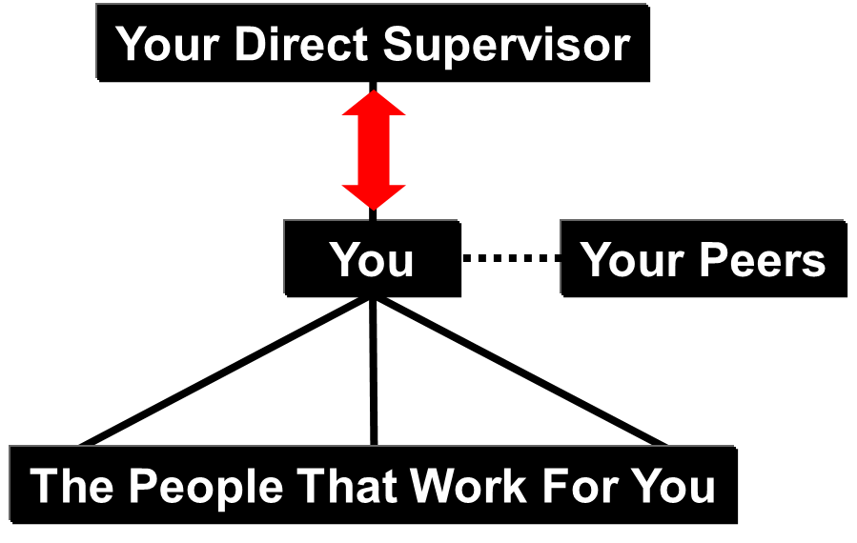
Dilemma: Work with Your Organization or Whistle-blow?
Recall the discussion on the relationship between you and your supervisor:
Seek clarity within your organization!
Your first step should be to work with your supervisor and within the organization – it could be a misunderstanding or miscommunication.
Your second step should be to work with and within your organization’s corporate policies to resolve the issue.
Chapter 6.4: Professionalism, Ethics and Equity, Integrity, Conflict of Interest
28
Notes:
ENGG404 2014F
28
28
26 November 2019

Slide 29
ALE: Dilemma: Work with Your Organization or Whistle-blow?
Go external from your organization:
Your third step: ultimately, if you cannot resolve the apparent conflict, you may be motivated to seek external avenues of inquiry (government authorities and regulators, professional associations) as a last resort ...
This action is termed “whistle-blowing”.
This is not a trivial action.
The process calls into question the integrity and ethics of the organization under scrutiny and of the whistle-blower.
Personal motivators may come into question: is it a grudge or an honest concern?
Chapter 6.4: Professionalism, Ethics and Equity, Integrity, Conflict of Interest
29
Notes:
ENGG404 2014F
29
29
Whistleblower: “A whistleblower is a person who exposes any kind of information or activity that is deemed illegal, unethical, or not correct within an organization that is either private or public.” https://en.wikipedia.org/wiki/Whistleblower accessed 3-Dec-2016
26 November 2019

Slide 30
Summary and Key Points:
You may find yourself in a challenging or compromising situation:
Professional misconduct,
Unethical behaviours,
Betray values of honesty, privilege and confidentialities,
Incompetent practice,
Negligent practice,
Conflict of interest,
Corruption.
If you give your decision options careful thought, make the ethical decision based on the appropriate set of positive values, check with others, and act on your values accordingly, … … you can manage yourself through obstacles like these with little difficulty and gain the admiration and respect of your fellow workers.
Chapter 6.4: Professionalism, Ethics and Equity, Integrity, Conflict of Interest
30
Notes:
ENGG404 2014F
30
30
26 November 2019

Slide 31
Summary and Key Points:
Our professionalism spans beyond our technical competencies, and includes ethical conduct, integrity, and pubic service (duty to the public).
Our moral compass as professionals is grounded in our hierarchy for applying ethics [1) I comply with the law. 2) I comply with the professional code. 3) etc.] in our making decisions.
If you are questioning whether the pending action (decision and/or behaviour) is ethical, and you cannot resolve that question, then ask for help to discuss and review the ethics of that decision.
Chapter 6.4: Professionalism, Ethics and Equity, Integrity, Conflict of Interest
31
Notes:
ENGG404 2014F
31
31
26 November 2019

